Slide 1
Preprocessing, spectral analysis and alignment
October 2024
Andrea Corrado

Slide 2
Outline
Recap of objectives so far
Signal preprocessing
Spectrum estimation
Signals alignment
Possible features of Rov Signals
Conclusions

Slide 3
Outline
Recap of objectives so far
Signal preprocessing
Spectrum estimation
Signals alignment
Possible features of Rov Signals
Conclusions

Slide 4
Recap of the objectives so far
So far, data has been explored to find out their inner characteristics.
Proprieties in time domain
Proprieties in frequency domain
To do it, three questions should be answered:
Does data require preprocessing? Which could be a good pipeline?
How can we evaluate the frequency characteristics of these signals?
Does data require to be aligned? If yes, how proceed with alignment?
Target : building a population dataset

Slide 5
Outline
Recap of objectives so far
Signal preprocessing
Spectrum estimation
Signals alignment
Possible features of Rov Signals
Conclusions

Slide 6
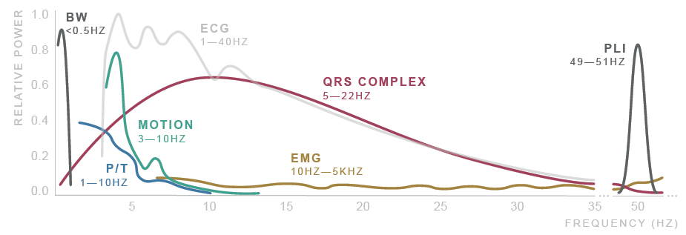
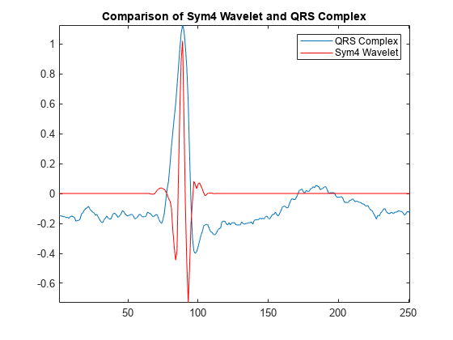
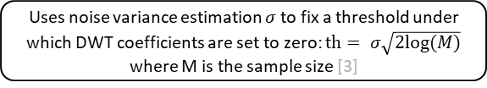
Signal preprocessing
ECG signals noisy and require to be preprocessed and filtered [1]
Noise sources: Physiological, Environmental, Artifacts, Electronic…
After literature research, the proposed filtering method [1,2] consists of:
Donoho thresholding [3] on discrete wavelet transform coefficients (DWT)
Shrink the coefficients related to, presumably, high frequency noise and low frequency noise
Followed by zero-phase band pass filtering
Improves the result eliminating residual noise
Original signal
DWT decomposition
Symlets 4 wavelet is used due to its good performances on ECG signals [2, 3]
Donoho soft thresholding
Uses noise variance estimation $σ$ to fix a threshold under which DWT coefficients are set to zero: $th= σ\sqrt{2log⁡(M)}$ where M is the sample size [3]
DWT reconstruction
Butterworth HP filter (order 6, cutoff at 1 Hz)
Butterworth LP filter (order 6, cutoff at 60 Hz)
1. Saraiva, João & Plácido da Silva, Hugo & Fred, Ana. (2022). Denoising and Artifact Removal of the Electrocardiogram, Electrodermal Activity and Accelerometery for Continuous Ambulatory Monitoring of Epileptic Seizures with Wearable Devices.
2. Singh, Brij N., and Arvind K. Tiwari. "Optimal selection of wavelet basis function applied to ECG signal denoising." Digital signal processing 16.3 (2006): 275-287.
3. Donoho, David L. "De-noising by soft-thresholding." IEEE transactions on information theory 41.3 (1995): 613-627.

Slide 7
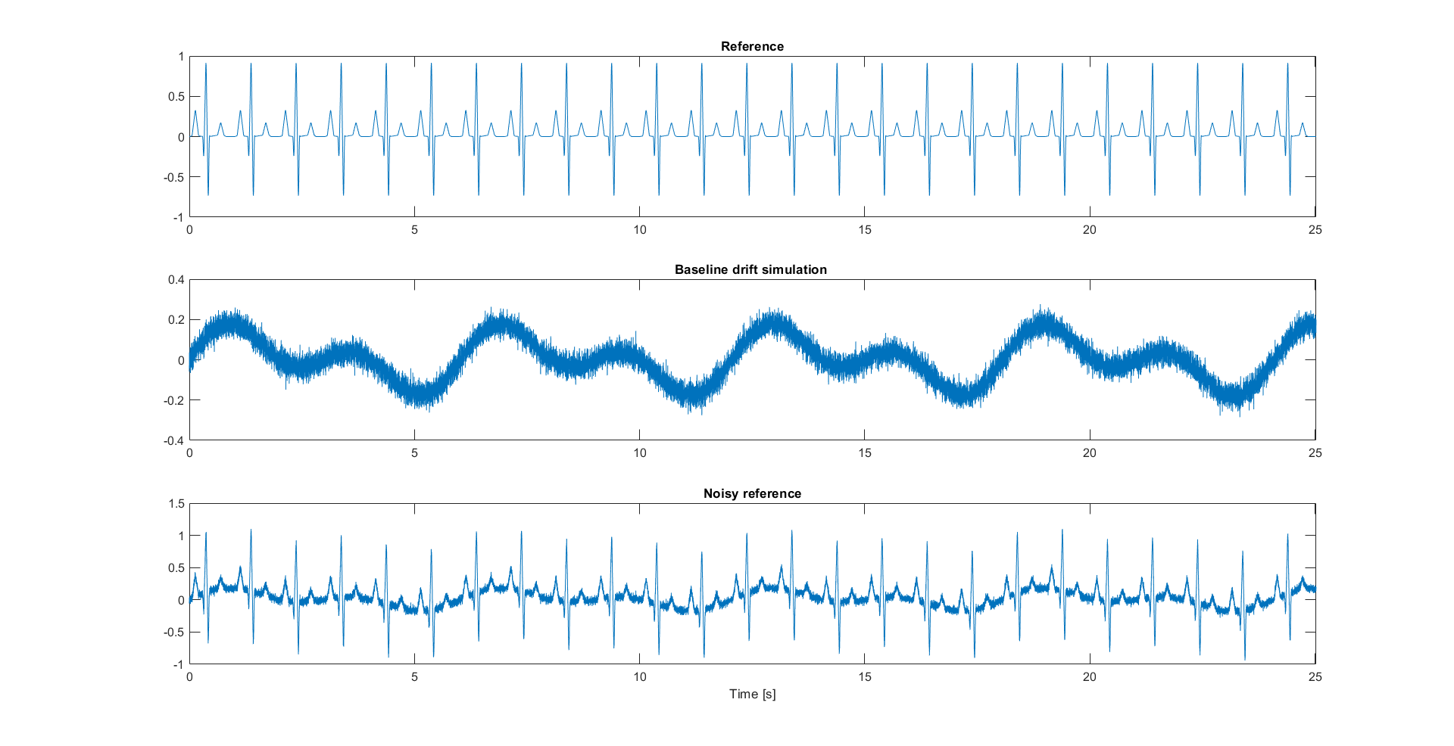
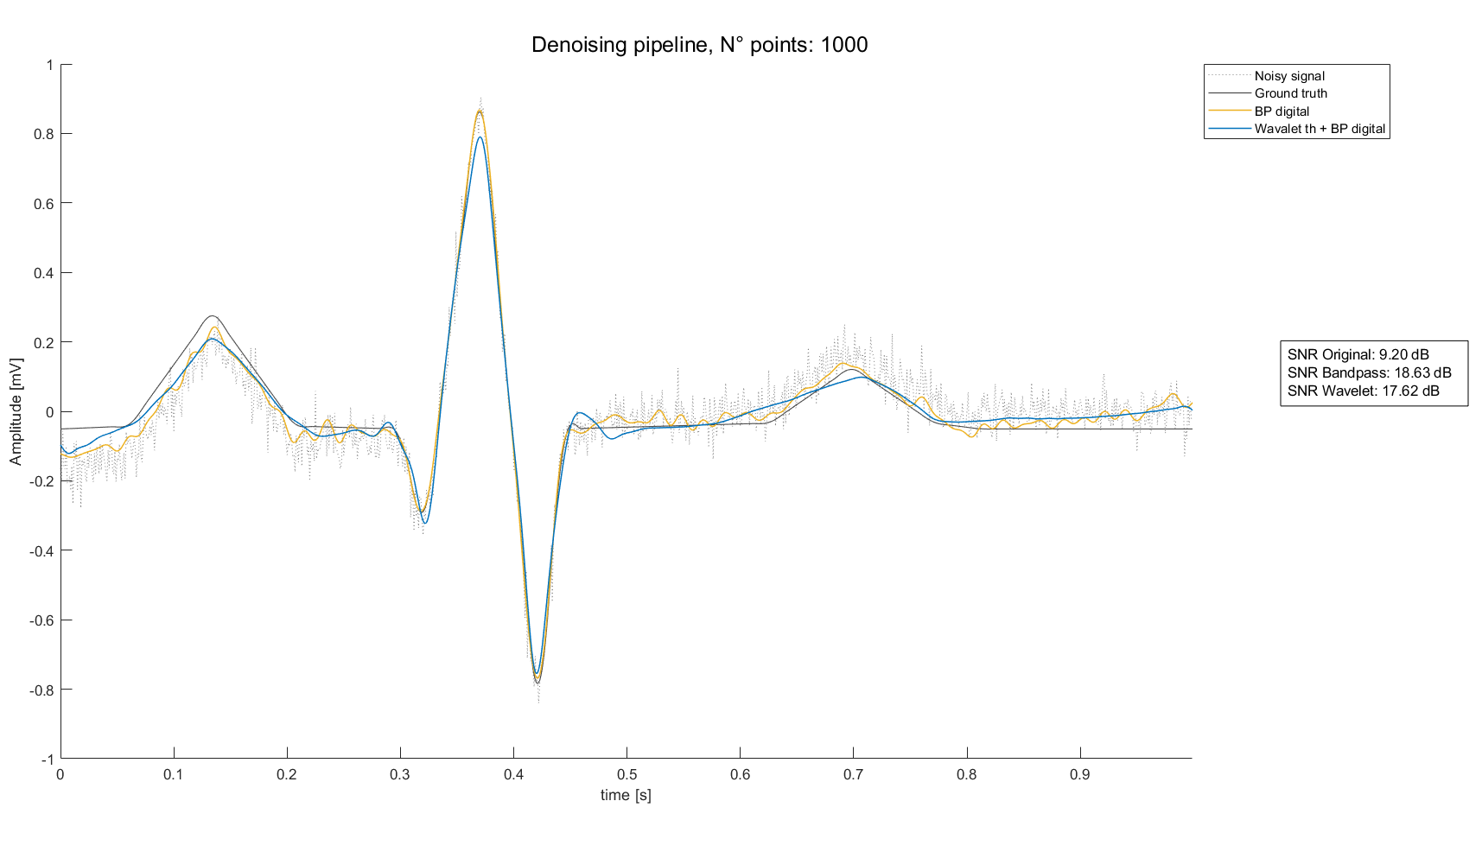
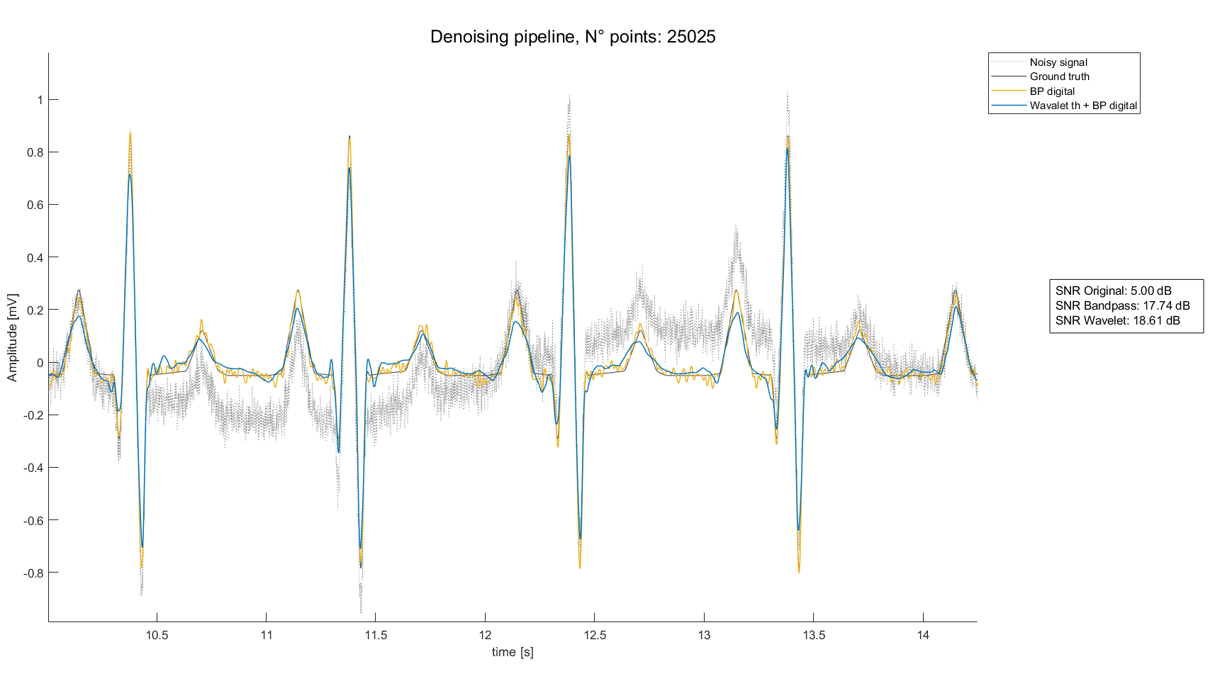
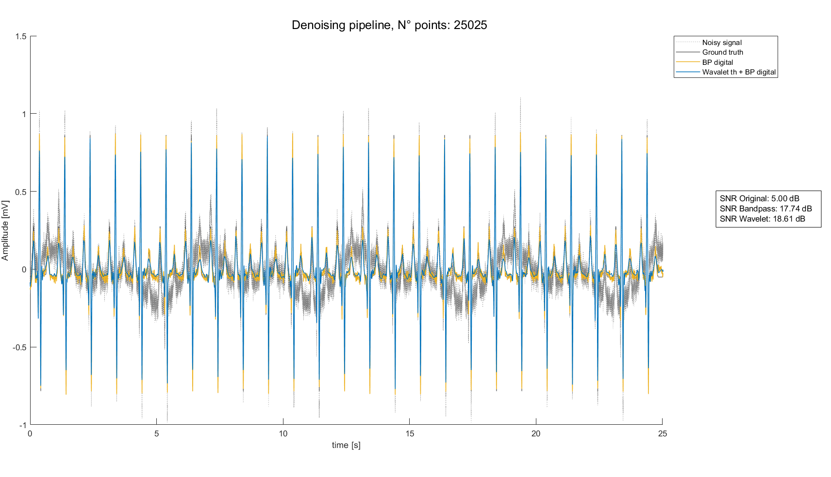
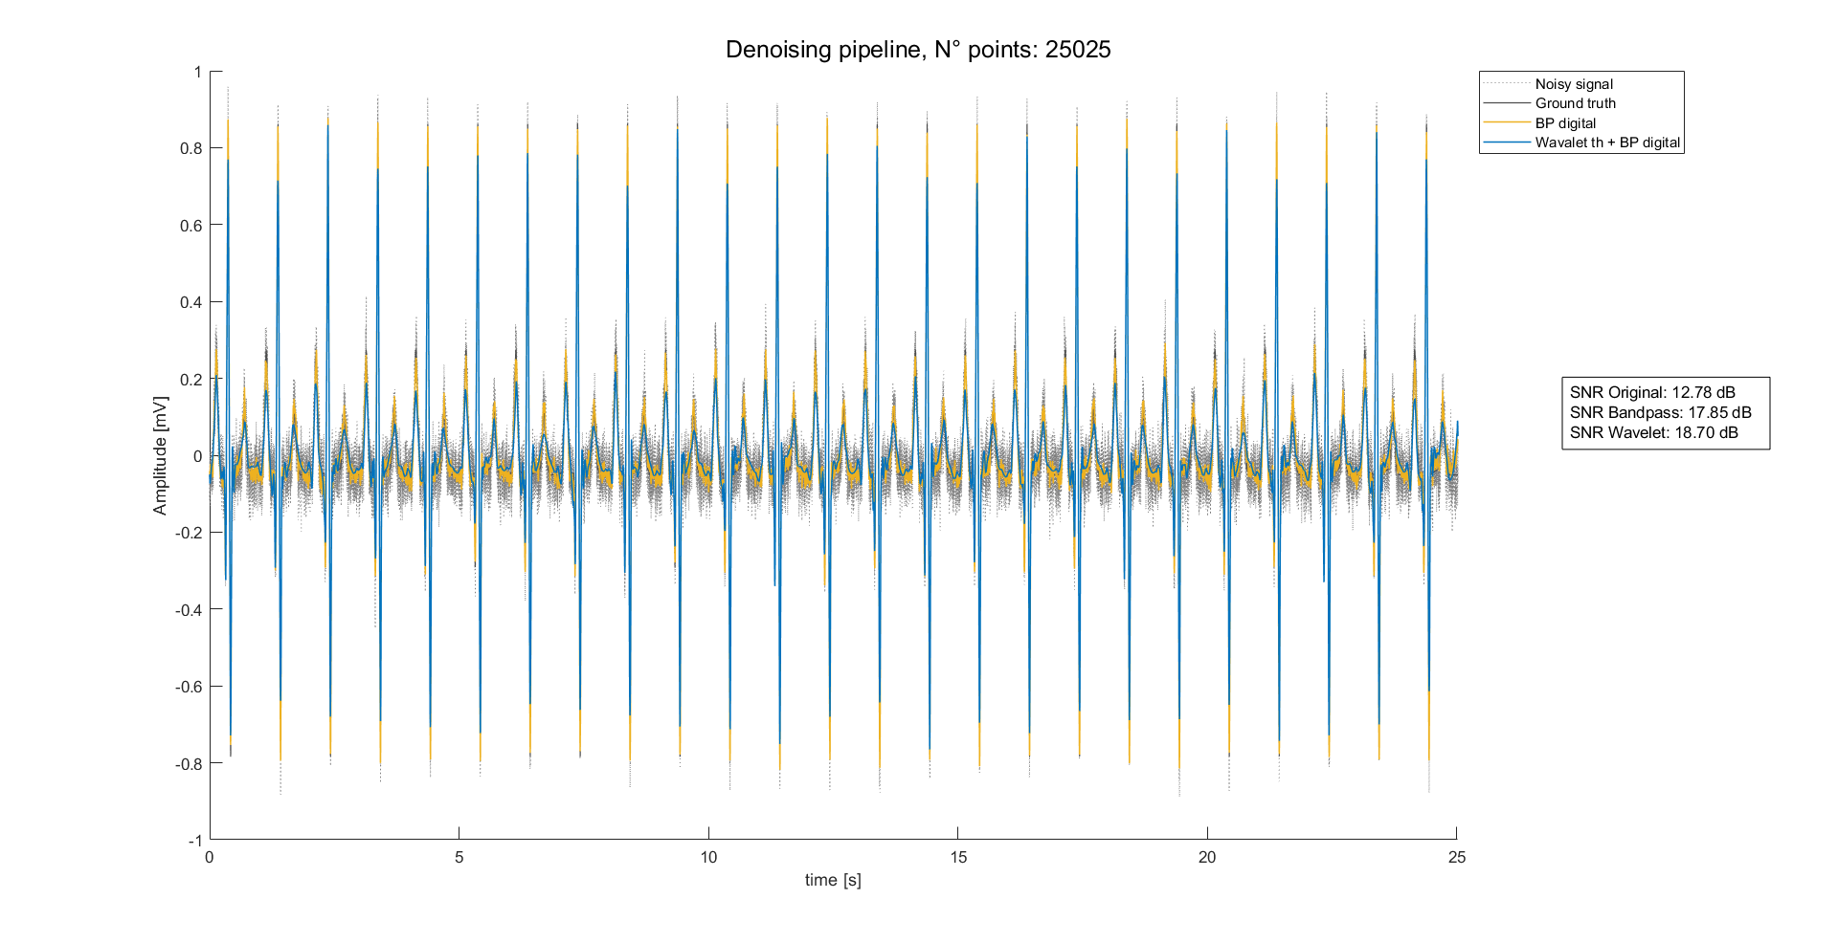
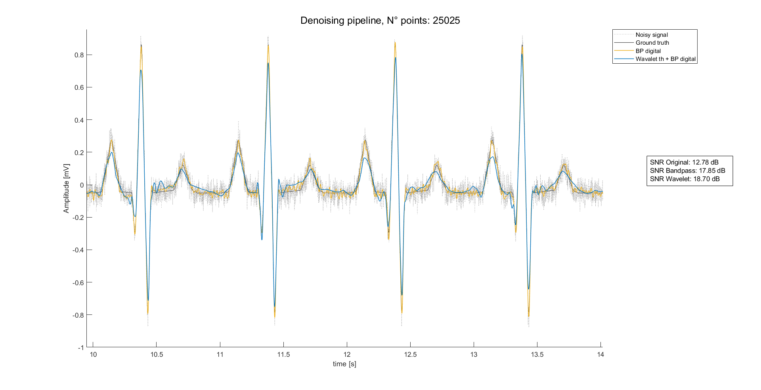
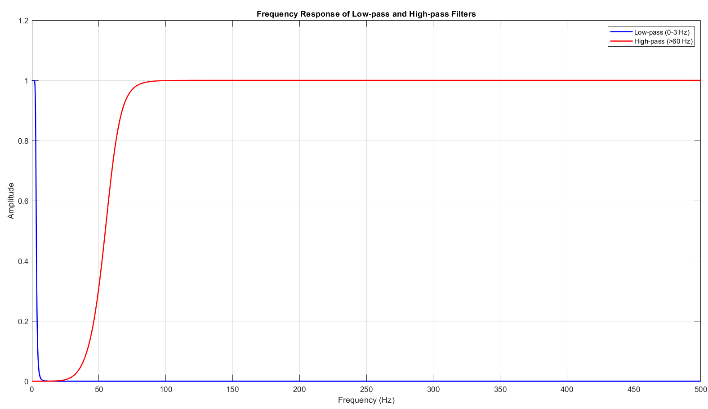
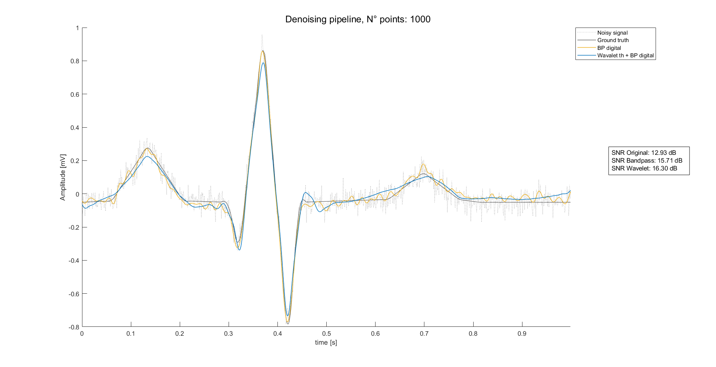
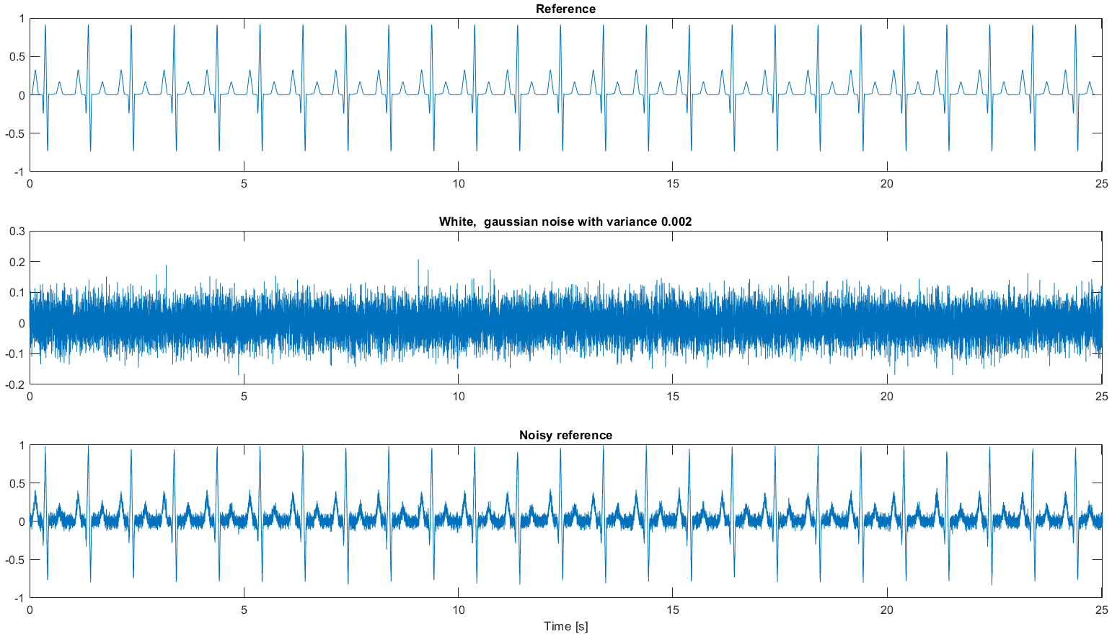
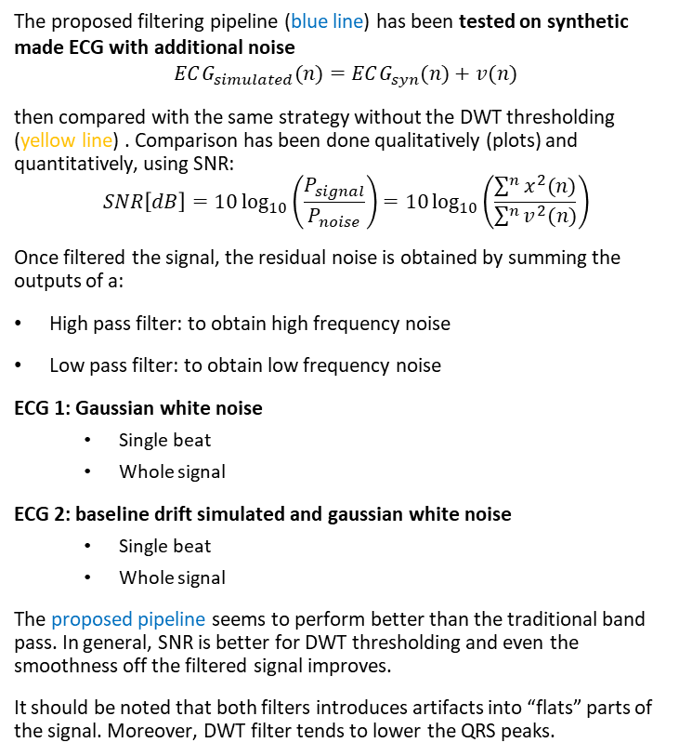
Preprocessing results: Synthetic data
The proposed filtering pipeline (blue line) has been tested on synthetic made ECG with additional noise
$$ECG_{simulated}(n)=ECG_{syn}(n)+v(n)$$
then compared with the same strategy without the DWT thresholding (yellow line) . Comparison has been done qualitatively (plots) and quantitatively, using SNR:
$$SNR\left[dB\right]=10\log_{10}\left(\frac{P_{signal}}{P_{noise}}\right)=10\log_{10}\left(\frac{\sum^{n}{x^{2}(n)}}{\sum^{n}{v^{2}(n)}}\right)$$
Once filtered the signal, the residual noise is obtained by summing the outputs of a:
High pass filter: to obtain high frequency noise
Low pass filter: to obtain low frequency noise
ECG 1: Gaussian white noise
Single beat
Whole signal
ECG 2: baseline drift simulated and gaussian white noise
Single beat
Whole signal
The proposed pipeline seems to perform better than the traditional band pass. In general, SNR is better for DWT thresholding and even the smoothness off the filtered signal improves.
It should be noted that both filters introduces artifacts into “flats” parts of the signal. Moreover, DWT filter tends to lower the QRS peaks.

Slide 8
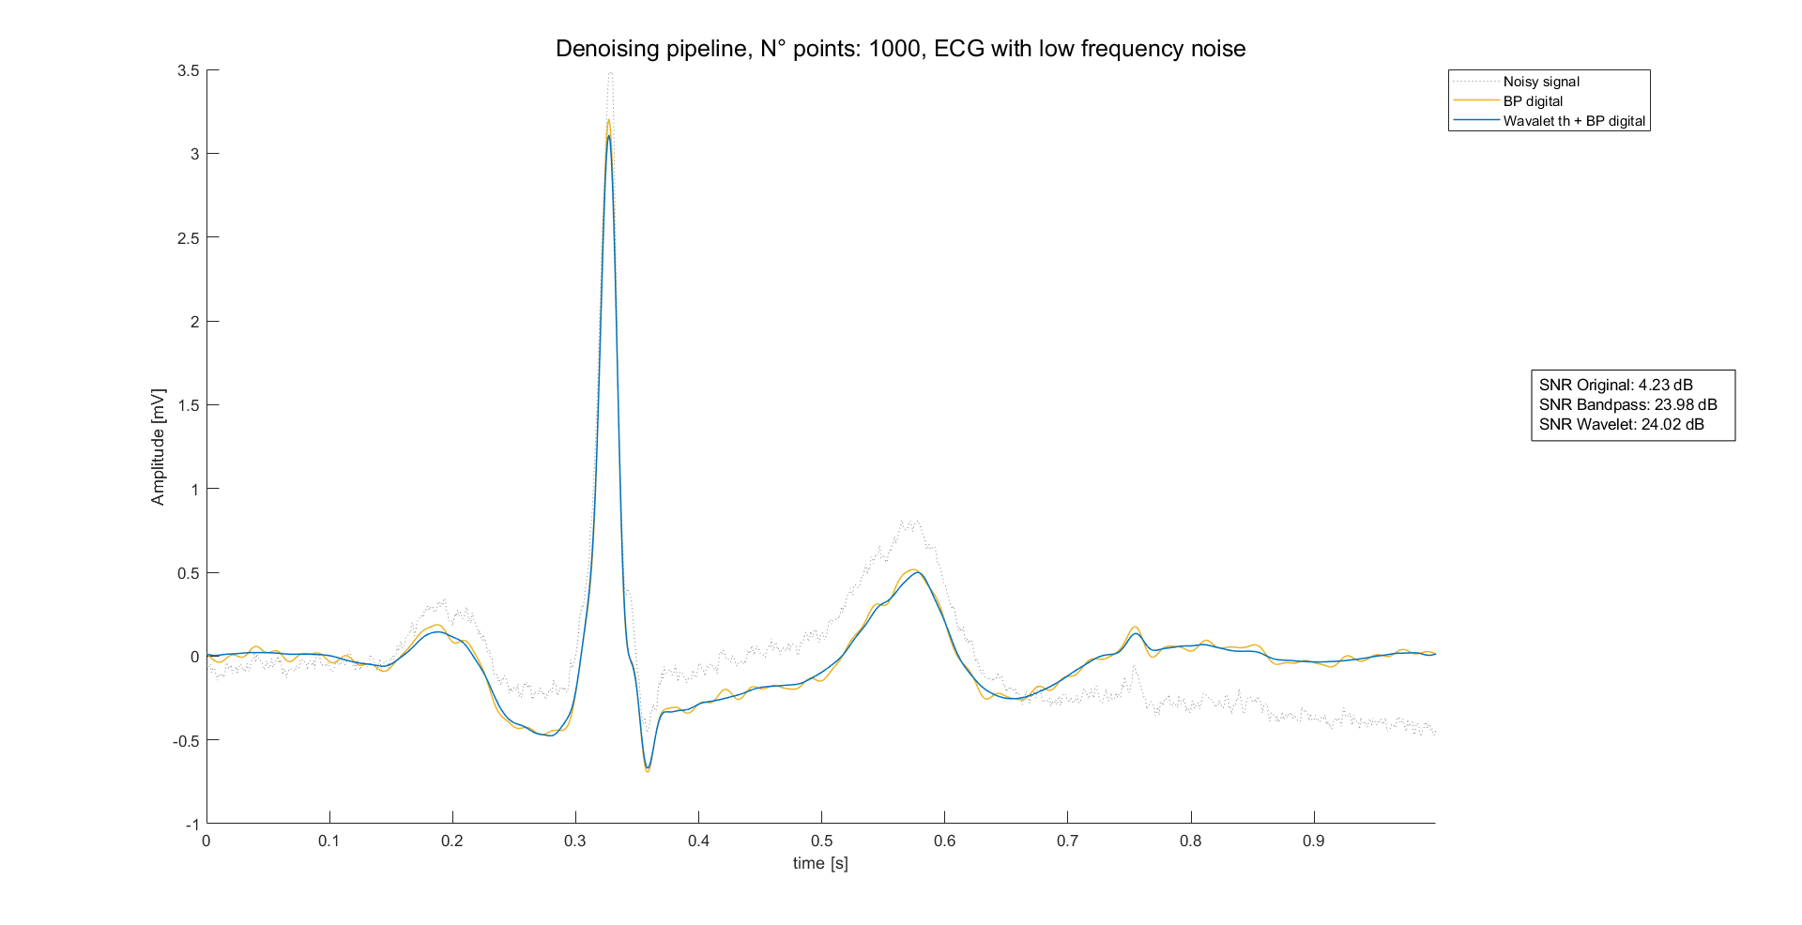
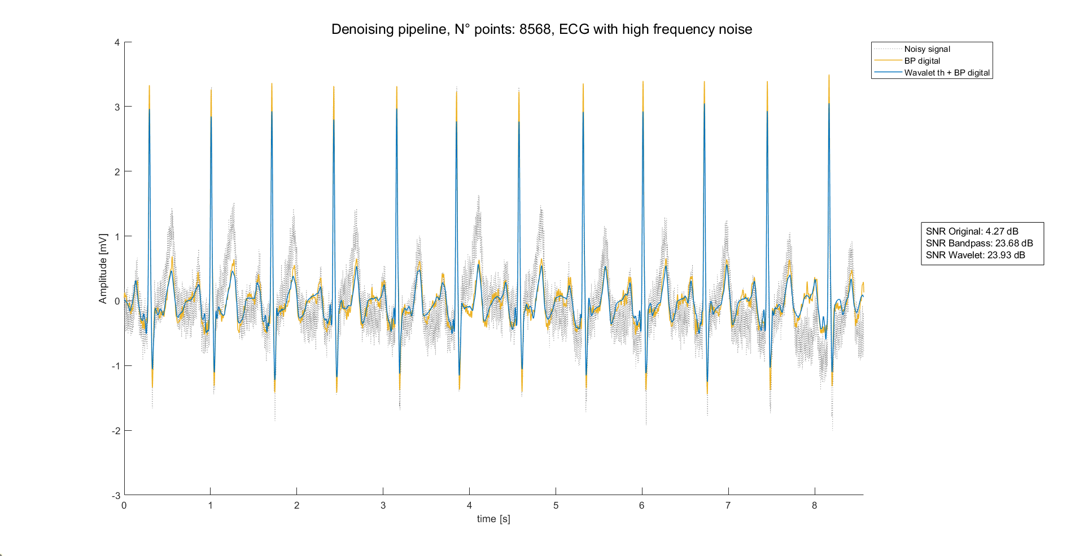
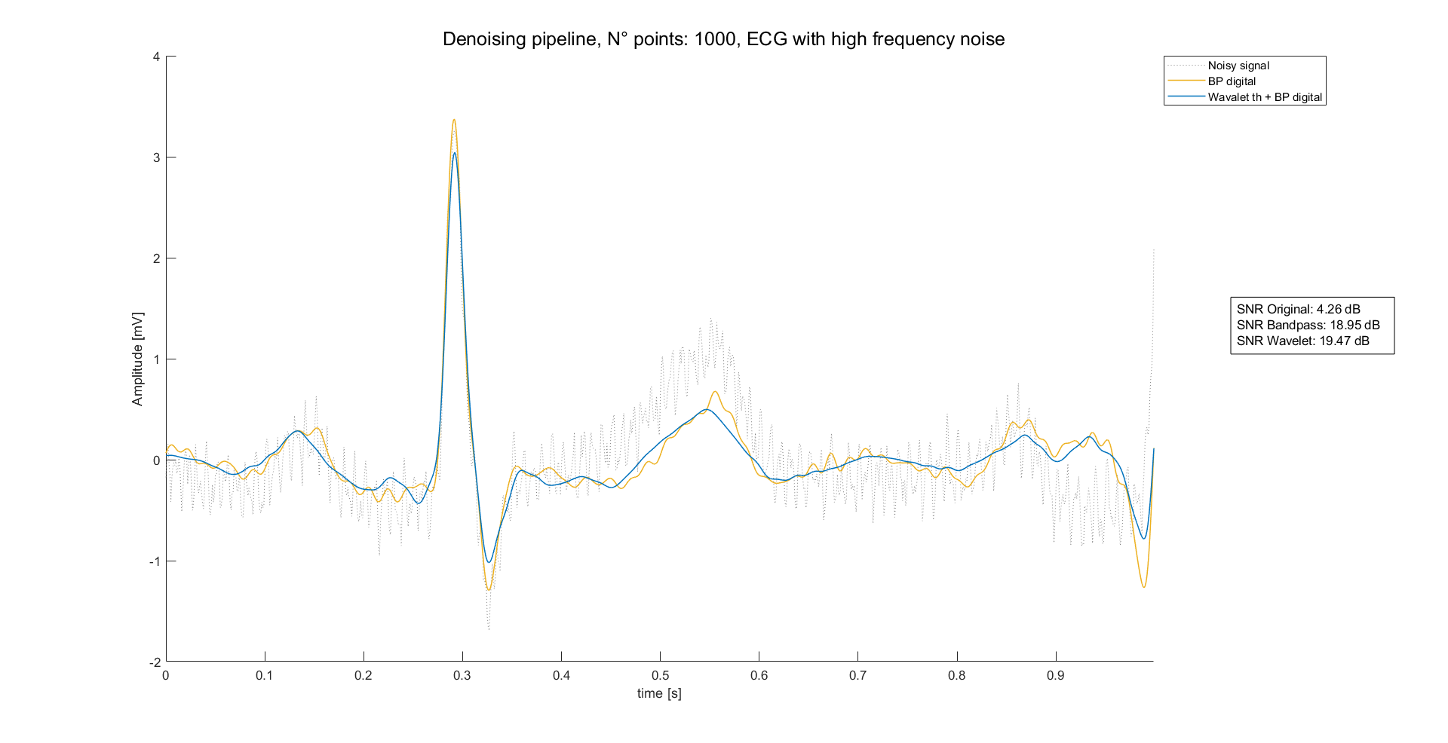
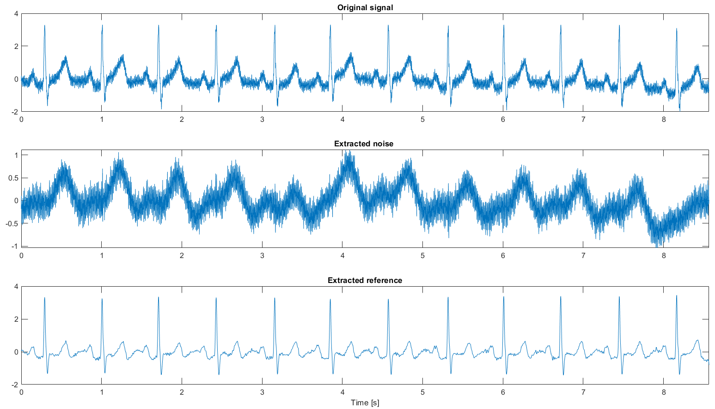
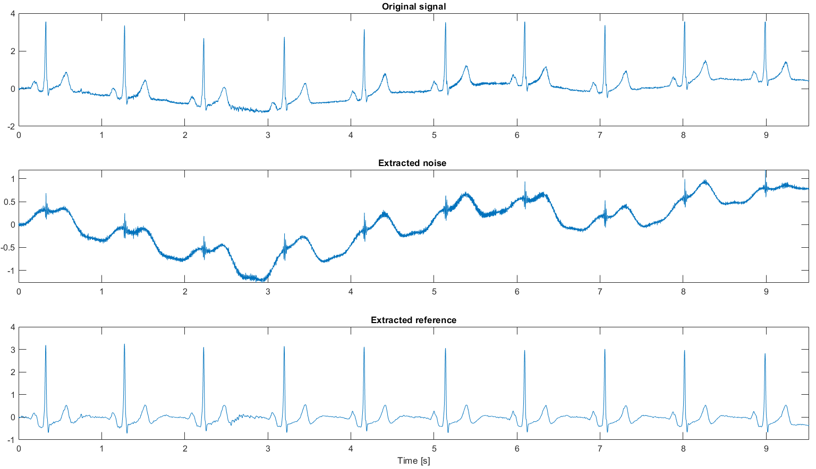
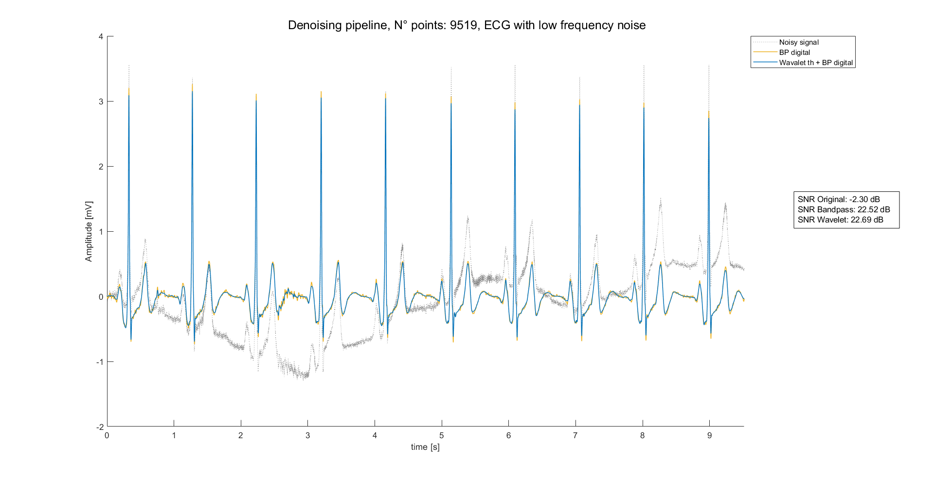
Preprocessing results: External data
The proposed filtering pipeline (blue line) has been tested on well-know external data (didactical) and compared with the same strategy without the DWT thresholding (yellow line). Again, results are both qualitative and quantitative (SNR).
Again, there are 2 scenarios:
ECG 1: HF noise
Filter performance on single beat
Filter performance on whole signal
ECG 2: LF noise
Filter performance on single beat
Filter performance on whole signal
In conclusion, DWT thresholding combined with BP zero-phase filtering leads to good results.
Moreover, this strategy has other known advantages:
Higher performance even on other sources of noise [1]
Good performances on short signals [1,2]
1. Saraiva, João & Plácido da Silva, Hugo & Fred, Ana. (2022). Denoising and Artifact Removal of the Electrocardiogram, Electrodermal Activity and Accelerometery for Continuous Ambulatory Monitoring of Epileptic Seizures with Wearable Devices.
2. Singh, Brij N., and Arvind K. Tiwari. "Optimal selection of wavelet basis function applied to ECG signal denoising." Digital signal processing 16.3 (2006): 275-287.

Slide 9
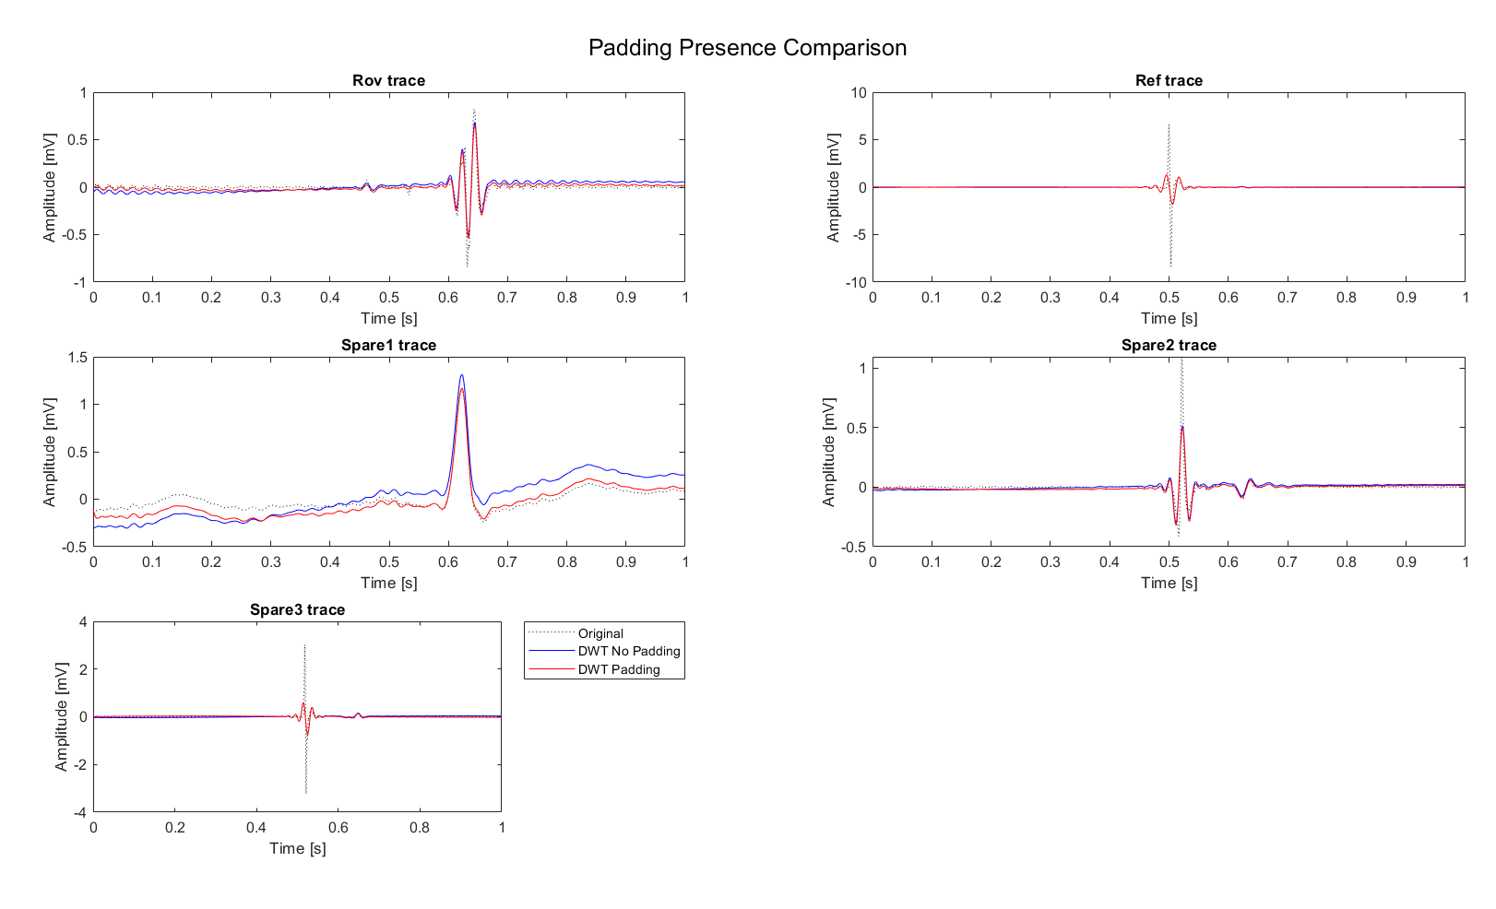
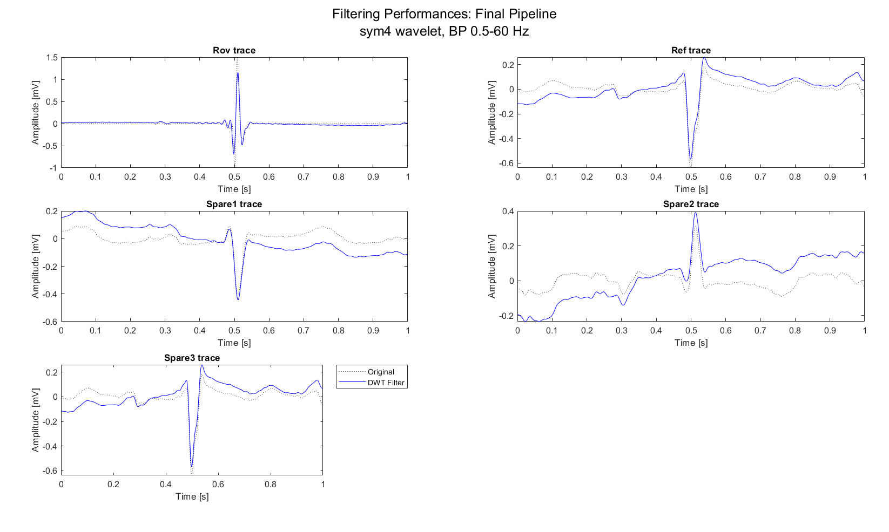
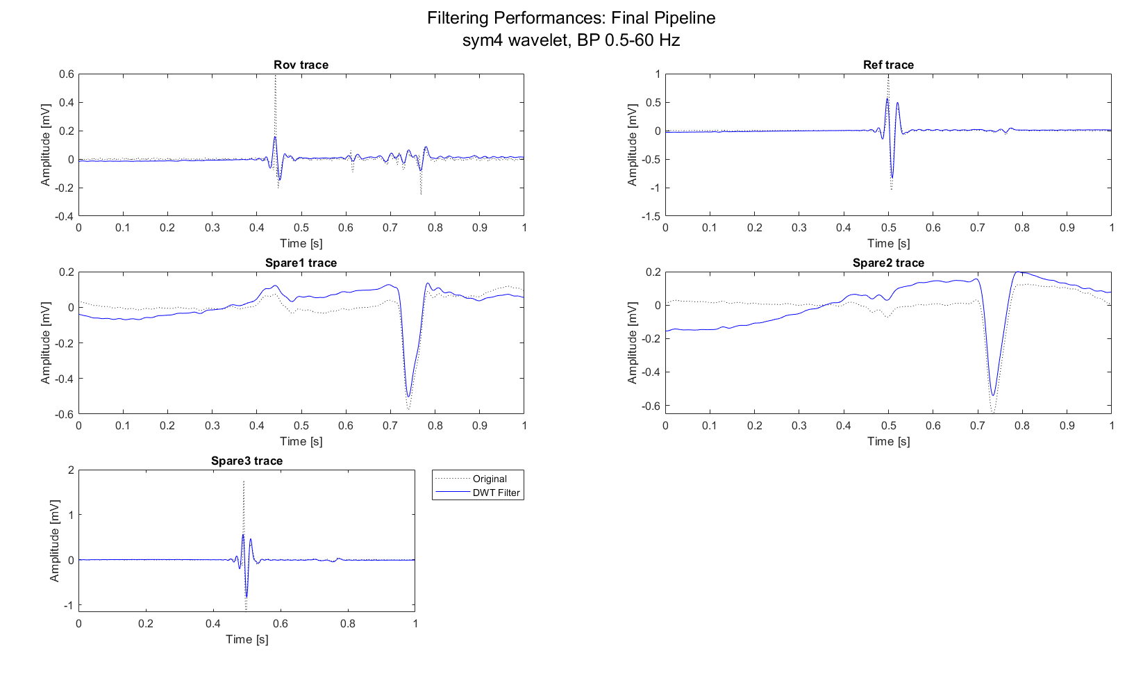
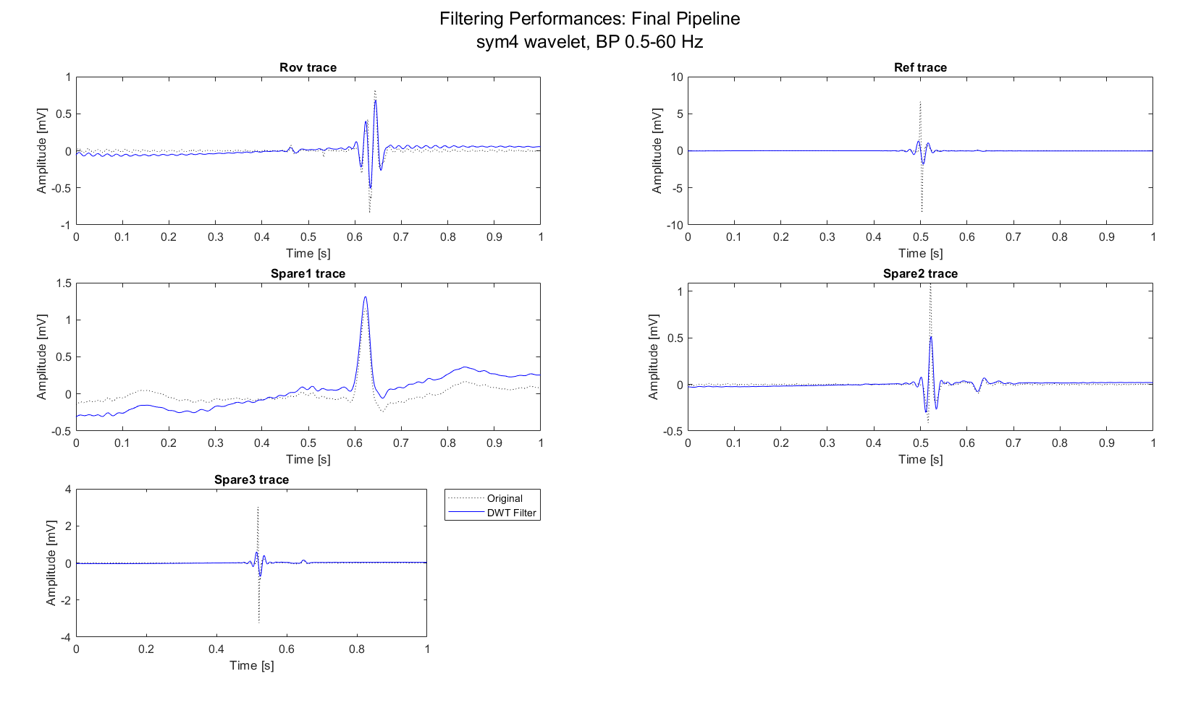
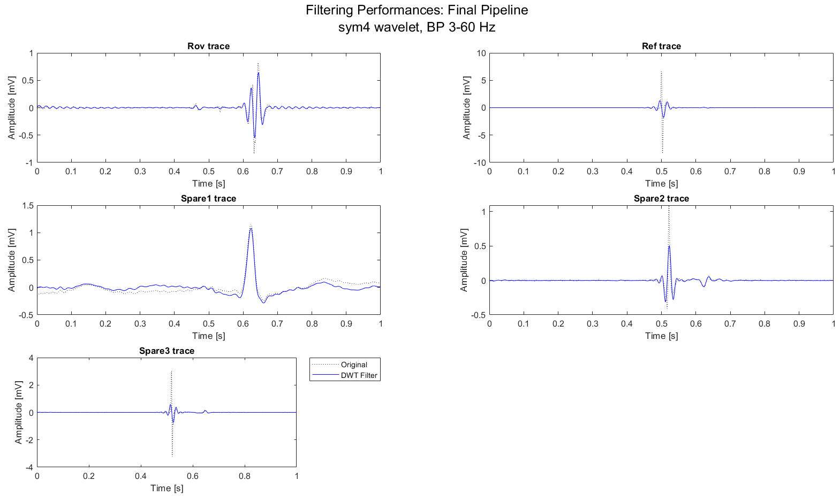
Preprocessing results: AVNRT data
Once build the method into a controlled environment, it can be tested on AVNRT data:
MAP C, sub-1, record example
MAP C, sub-7, record example
MAP C, sub-8, record example
As can be seen:
Zero-phase ensures the preservation of peaks location
Important peaks (A-H-V) preserved
Clearly visible peaks lowering
Presence of boundary effects
Mirror padding of 400 points slightly lower these effects
While if the lower cutoff frequency is higher, like 3 Hz, boundary effects are clearly reduced

Slide 10
Conclusions on preprocessing
A robust preprocessing pipeline it has been evaluated on ECG signals:
Simulated environment leads to good results and opens the door for a real-life scenario
Didactical examples enhancing the usage of DWT + BP strategy, choice even supported by literature
AVNRT data require little adaptations of the pipeline. In any case, high frequency components of some signal present in the database are very muted.
In conclusion, DWT + BP pipeline is a strong and reliable tool that can be used in the following steps.
Two aspects should also be considered when choosing whether to apply preprocessing:
Presence of previously made preprocessing:
Is know that ECG signals are pre-filtered within 0.5 and 50 Hz
While Catheters signals (CS, Roving) are pre-filtered within 30 and 300 Hz.
Nature and typology of features
A possible future scenario could be a comparison between classification made on features from filtered data and classification made on features from original data.

Slide 11
Outline
Recap of objectives so far
Signal preprocessing
Spectrum estimation
Signals alignment
Possible features of Rov Signals
Conclusions

Slide 12
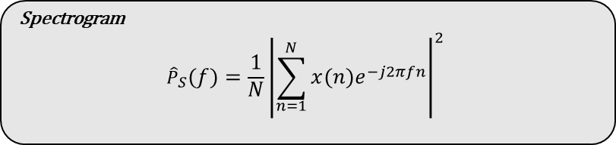
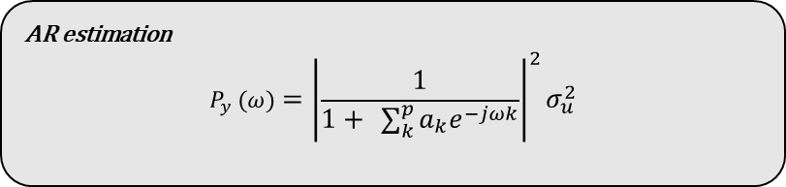
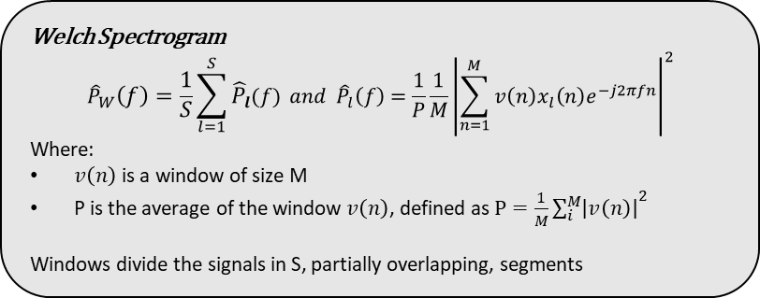
Spectrum estimation
Spectrum estimation can be done following different strategies:
Parametric strategies: i.e., AR estimation
Require zero mean, stationary signals
Consistent and not windowed spectrum estimation
Easy and fast application
Order choice and parameters estimator are crucial
Non-Parametric Strategies: i.e., Spectrogram or Welch estimation
Tend to be noisy
Could require windowing
Easy and fast application
Literature suggest the usage of Non-parametric strategies on ECG signals, but it’s clearly a trade off:
On one hand, AR estimation cannot be used because of non-verification of the signal hypothesis: ECG signals are not stationary.
On the other hand, Non-parametric strategies are noisy and hard to interpretate.
AR estimation
$$P_{y} (ω)={\left|\frac{1}{1+ \sum_{k}^{p}{a_{k}e^{−jωk}}}\right|}^{2}σ_{u}^{2}$$
Spectrogram
$${\hat{P}}_{S}\left(f\right)=\frac{1}{N}{\left|\sum_{n=1}^{N}{x\left(n\right)e^{−j2πfn}}\right|}^{2}$$
Welch Spectrogram
$${\hat{P}}_{W}\left(f\right)=\frac{1}{S}\sum_{l=1}^{S}{{\hat{P}}_{l}(f)} and {\hat{P}}_{l}\left(f\right)=\frac{1}{P}\frac{1}{M}{\left|\sum_{n=1}^{M}{v\left(n\right)x_{l}\left(n\right)e^{−j2πfn}}\right|}^{2}$$
Where:
$v\left(n\right)$ is a window of size M
P is the average of the window $v\left(n\right)$, defined as $P=\frac{1}{M}{\sum_{i}^{M}{\left|v\left(n\right)\right|}}^{2}$
Windows divide the signals in S, partially overlapping, segments

Slide 13
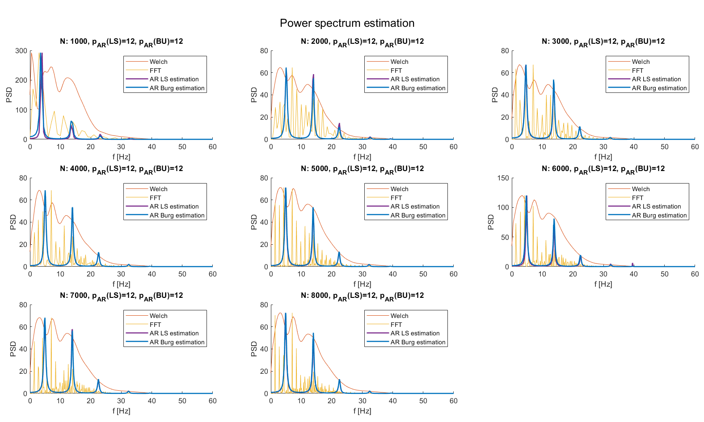
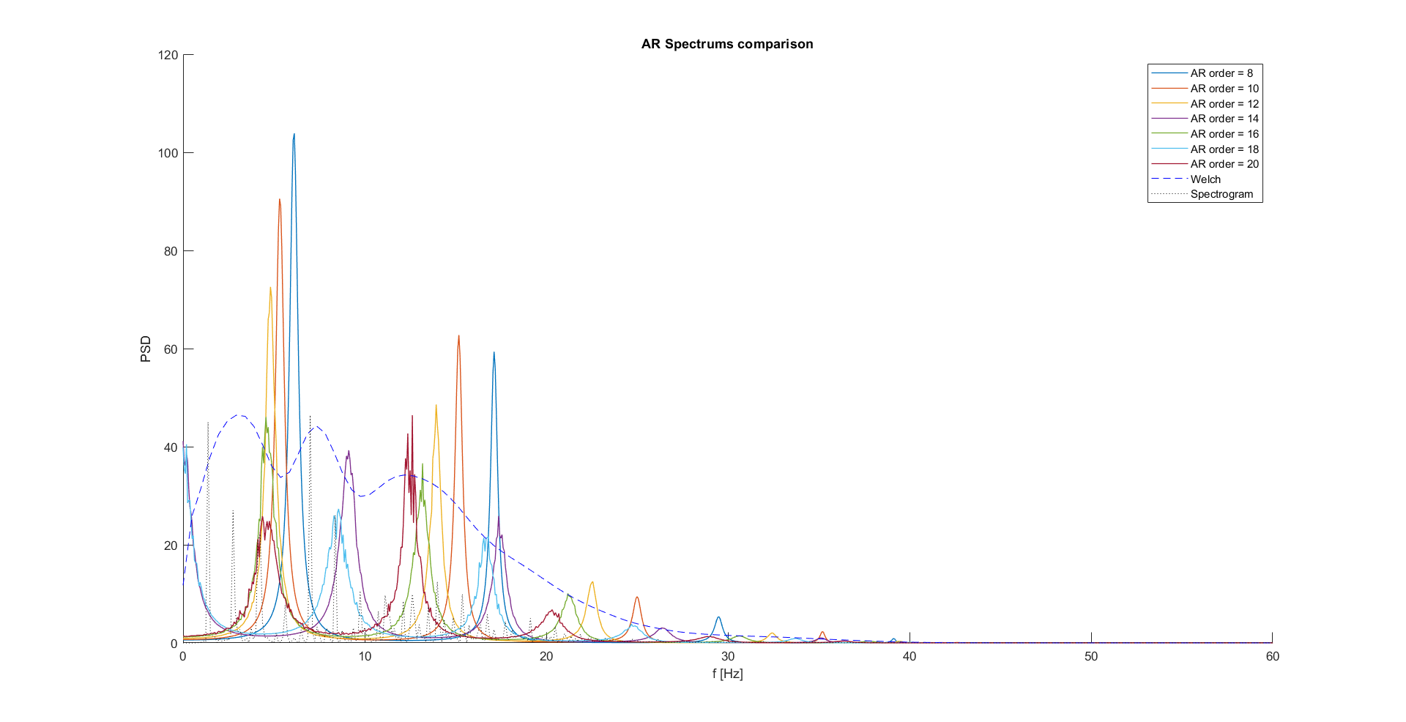
Spectrum estimation results: External data
The proposed spectrum estimation pipeline has been tested on well-know external data (didactical) and compared with the more used Spectrogram and Welch spectrogram.
Each subplot correspond to a spectrum evaluation of a HF noise corrupted signal with an increased number of points (i.e., beats) filtered with the proposed pipeline.
Burg and LS estimators converge, but AR spectrums, Welch spectrums and spectrograms does not lead to comparable results.
AR estimation seems to underestimate the signal, thus AR spectrum peaks are not aligned with the Welch ones.
Moreover, by changing the order, AR spectrum peaks moves, leading to the conclusion that AR spectral estimation does not provide satisfactory results.
Spectrum estimation is still an open problem to be investigated in the future.
LS estimation

Slide 14
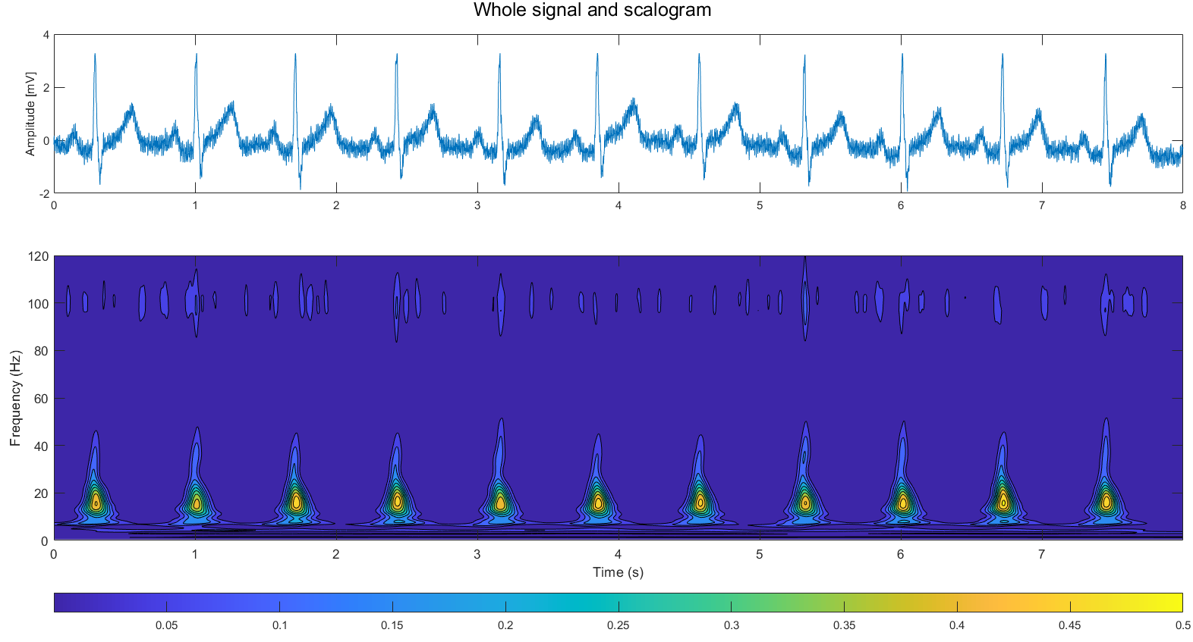
Spectrum estimation: comments
Now a dilemma arises:
On one hand, is known that spectral estimation could leave important insights on the data characteristics
On the other hand, traditional methods have inner limitations that discourage (or even preclude) their usage.
So, are there other methods that can be used?
As done in other studies [3], from FFT spectrums could be extracted some distributional features (e.g., Spectrum density in certain sub-bands)
There are spectrum estimation techniques build to treat correctly semi-periodic signals as ECG, i.e., eigen-based methods [4]
Many studies use DWT features as descriptors of the frequency behavior of ECG signals [5,6]
Other uses even 2-D representations of DWT, i.e., scalograms [7]
3. G. Baldazzi, M. Orrù, G. Viola, e D. Pani, «Computer-aided detection of arrhythmogenic sites in post-ischemic ventricular tachycardia», Sci Rep, vol. 13, fasc. 1, p. 6906, apr. 2023
4. S. V. Vaseghi, Advanced digital signal processing and noise reduction, 2nd ed. Chichester: Wiley, 2001.
5. P. deChazal, M. O’Dwyer, e R. B. Reilly, «Automatic Classification of Heartbeats Using ECG Morphology and Heartbeat Interval Features», IEEE Trans. Biomed. Eng, lug. 2004
6. S. Faziludeen e P. V. Sabiq, «ECG beat classification using wavelets and SVM», in 2013 IEEE CONFERENCE ON INFORMATION AND COMMUNICATION TECHNOLOGIES, apr. 2013, pp. 815–818
7. Y. D. Daydulo, B. L. Thamineni, e A. A. Dawud, «Cardiac arrhythmia detection using deep learning approach and time frequency representation of ECG signals», BMC Med Inform Decis Mak, vol. 23, fasc. 1, p. 232, ott. 2023

Slide 15
Outline
Recap of objectives so far
Signal preprocessing
Spectrum estimation
Signals alignment
Possible features of Rov Signals
Conclusions

Slide 16
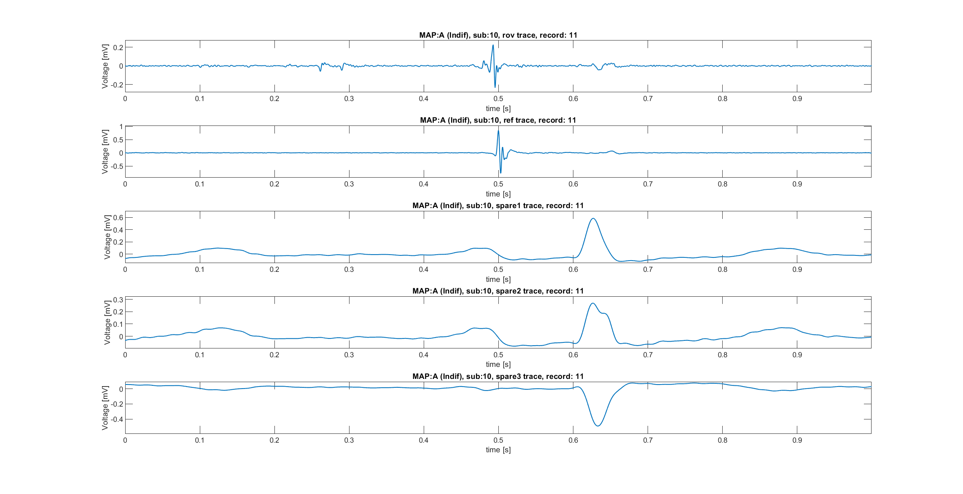
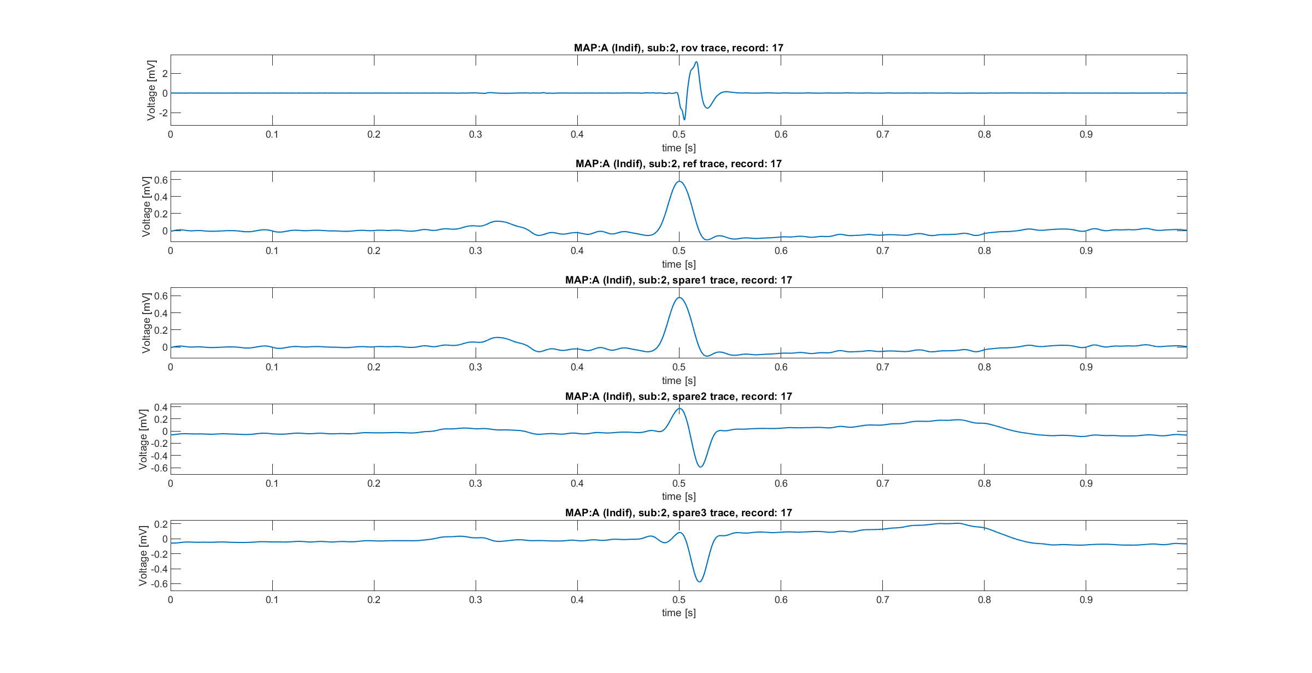
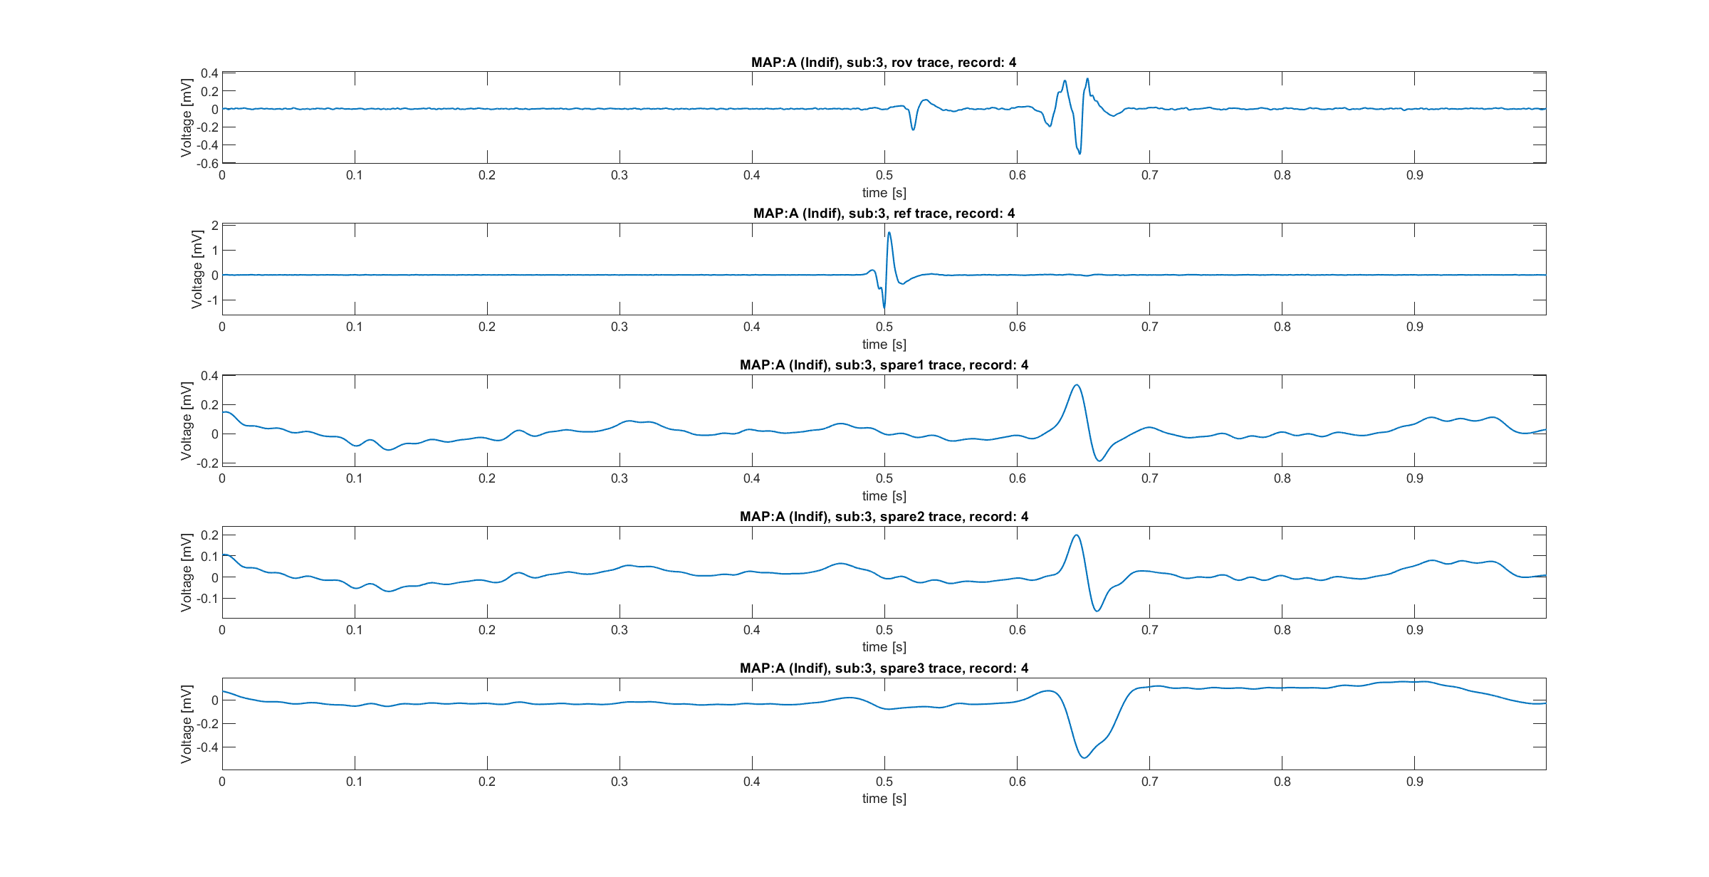
Alignment necessity
Alignment was found to be necessary to build a population dataset. In fact:
Localize correctly atrial, ventricular and His conduction is fundamental
Between subjects, there are differences into the peak’s alignment
The key idea is aligning the Rov trace respect to a QRS. Presumably, the Ref trace should play the role of trace against which align.
But:
Reference traces does not seem to contain always a QRS
Reference traces, as said in previous meetings, should be the same as spare 1 traces, but this is not true (or at least it is just for subjects 2 and 4)
Next slide partially respond to these observations
Atrial
Ventricular

Slide 17
Data summary and overview [from first presentation]
Data hierarchy
 | Number of records for subjects and maps
Sub | 1 | 2 | 3 | 4 | 5 | 6 | 7 | 8 | 9 | 10 | 11 | 12
MAP A | 97 | 78 | 80 | 193 | 80 | 256 | 11 | 18 | 7 | 11 | 18 | 27
MAP B | 11 | 5 | 22 | 20 | 22 | 14 | 6 | 9 | 7 | 5 | 3 | 18
MAP C | 5 | 7 | 16 | 32 | 16 | 11 | 2 | 11 | 5 | 4 | 5 | 24
MAP A
MAP B
MAP C
For each map, 12 Subjects
For each subject, 5 Traces
For each trace, the origin is specified into the .csv file
Surface ECG records (12 Leads)
Reference, spare traces
Catheters records (CS, Roving)
Rov trace, reference and possibly spare trace
Basic observations EDA
There aren’t missing values
Subjects 2 and 4 have spare 1 trace the same as reference trace
Subject 3 and 5 are the same subject
Rov
Ref
Spare 1 (Ref)
Spare 2
Spare 3
Fc: 2035Hz
Time duration: 1 s
Each trace has the same number of signals collected, which differs within maps and subjects
180 Traces

Slide 18
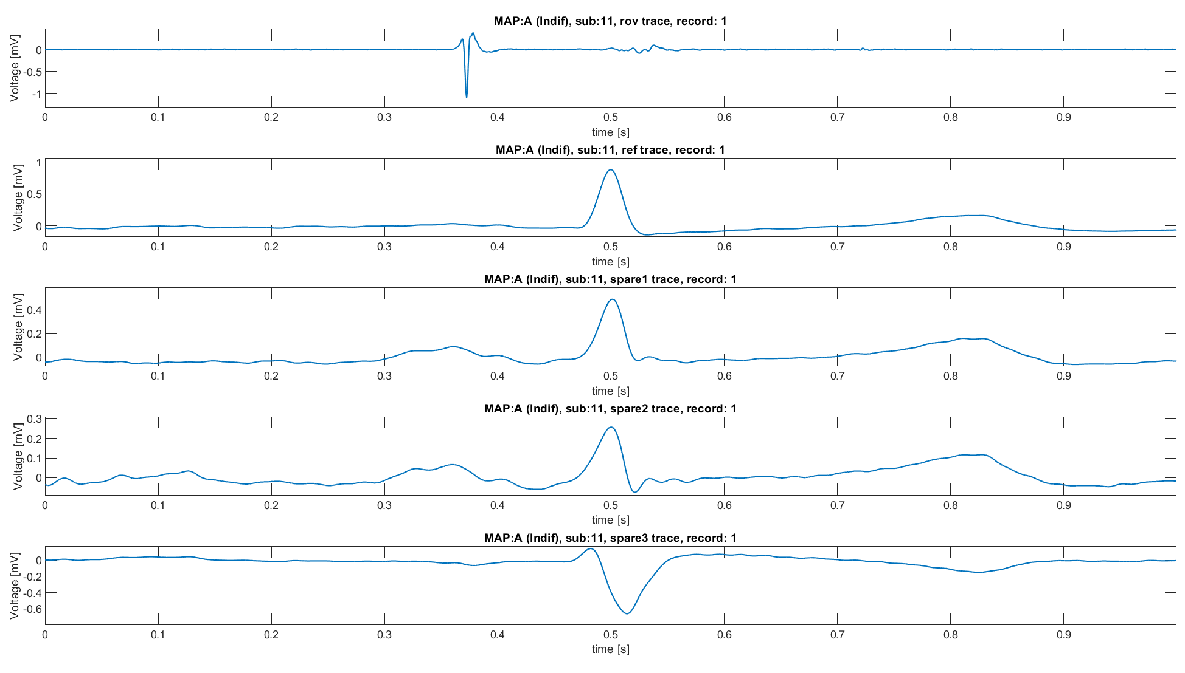
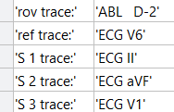
Examples of traces
Example of subject (7, map A) for which:
Rov trace: Ablative electrode
Reference trace: ECG V6 unipolar derivation
S1: ECG II derivation
S2 ECG aVF unipolar derivation
S3: ECG V1 unipolar derivation

Slide 19
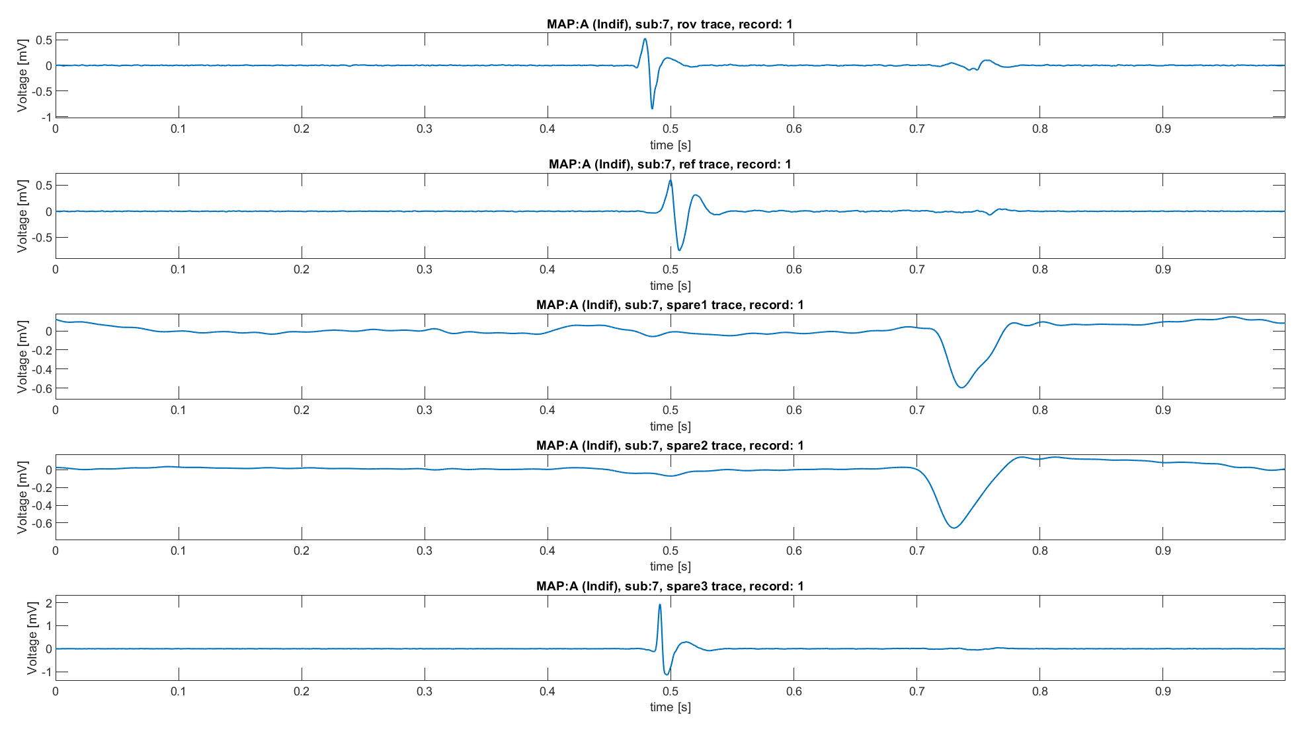
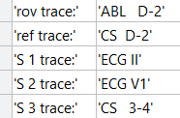
Examples of traces
Example of subject (7, map A) for which:
Rov trace: Ablative electrode
Reference trace: Coronary Sinus Electrode D - 2
S1: ECG II derivation
S2 ECG V1 unipolar derivation
S3: Coronary Sinus Electrode 3 – 4

Slide 20
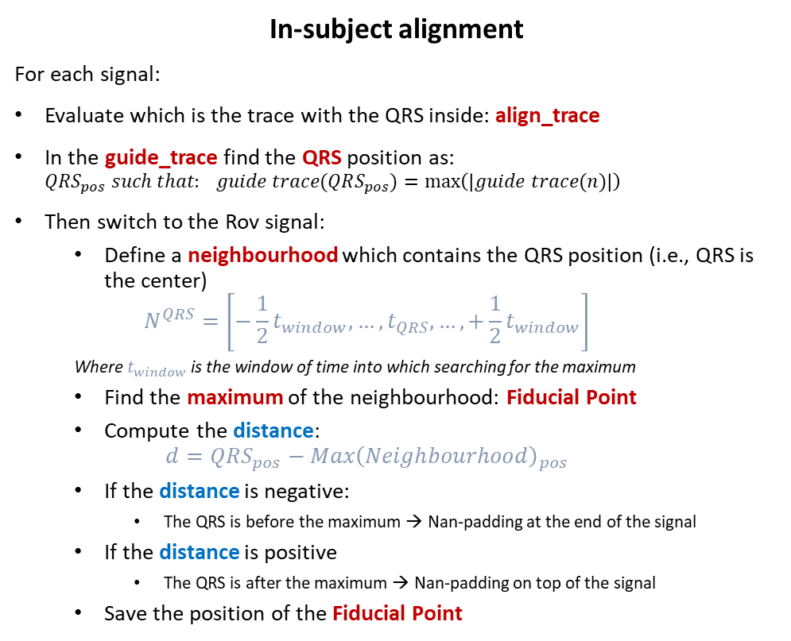
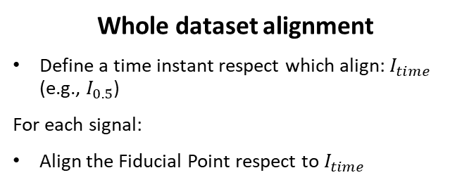
Traces alignment pipeline
In-subject alignment
For each signal:
Evaluate which is the trace with the QRS inside: align_trace
In the guide_trace find the QRS position as: $QRS_{pos} such that: guide trace(QRS_{pos})=\max\left(\left|guide trace(n)\right|\right)$
Then switch to the Rov signal:
Define a neighbourhood which contains the QRS position (i.e., QRS is the center)
$$N^{QRS}=\left[−\frac{1}{2}t_{window},…,t_{QRS},…,+\frac{1}{2}t_{window}\right]$$
Where $t_{window}$ is the window of time into which searching for the maximum
Find the maximum of the neighbourhood: Fiducial Point
Compute the distance:
$$d=QRS_{pos}−Max{\left(Neighbourhood\right)}_{pos}$$
If the distance is negative:
The QRS is before the maximum → Nan-padding at the end of the signal
If the distance is positive
The QRS is after the maximum → Nan-padding on top of the signal
Save the position of the Fiducial Point
Whole dataset alignment
Define a time instant respect which align: $I_{time}$ (e.g., $I_{0.5}$)
For each signal:
Align the Fiducial Point respect to $I_{time}$
Hyperparameter: Time window: 0.1 s

Slide 21
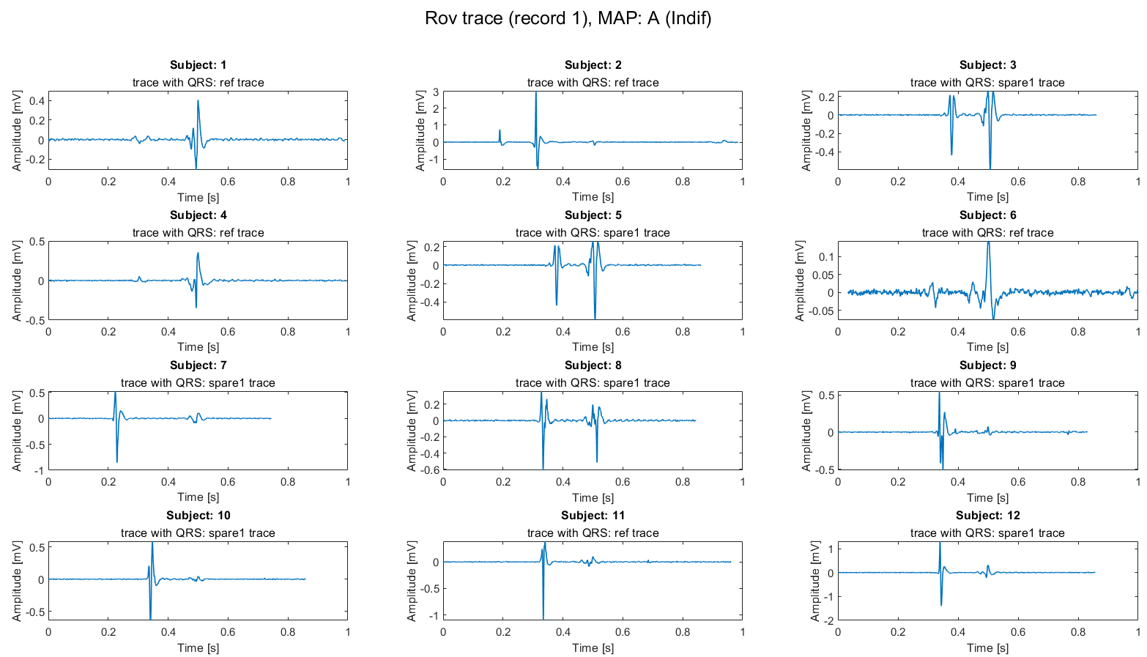
Results of alignment
This and next slides shows the results of the alignment strategy
MAP A
SUB 3 = SUB 5

Slide 22
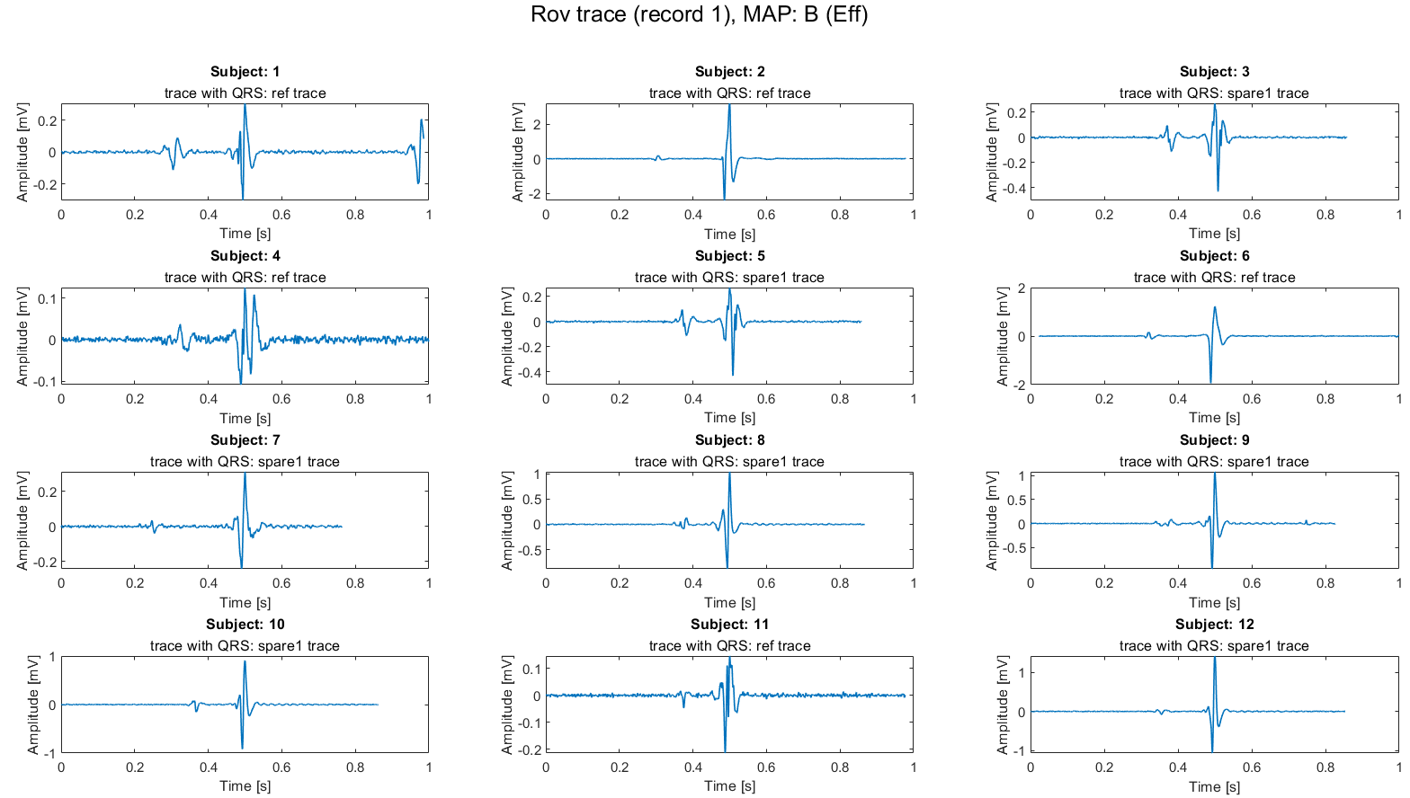
Results of alignment
MAP B
SUB 3 = SUB 5

Slide 23
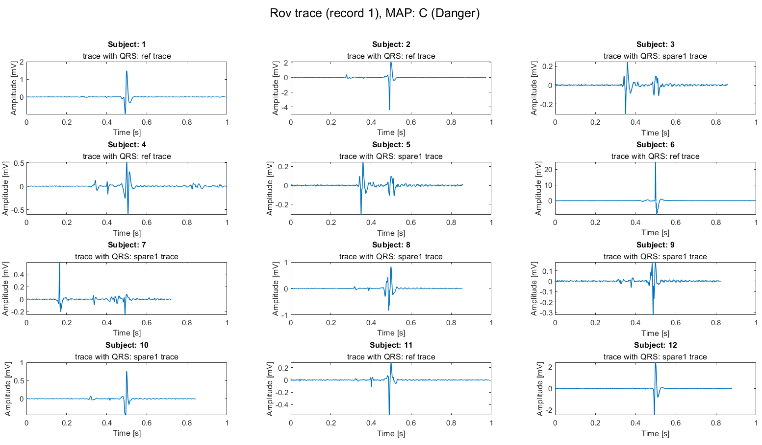
Results of alignment
MAP C
SUB 3 = SUB 5

Slide 24
Conclusions on alignment
A strong and adaptable alignment strategy has been proposed:
Based on data nature and origin
Strong by building: does not rely on hypothesis on traces but on real nature of traces
Adaptable by building: decide which trace use to align Rov traces according to the QRS presence and shift into the most suitable one
Such strategy, once repeated subjects have been dropped, allows to build a population dataset from which evaluate features and build a classification algorithm.

Slide 25
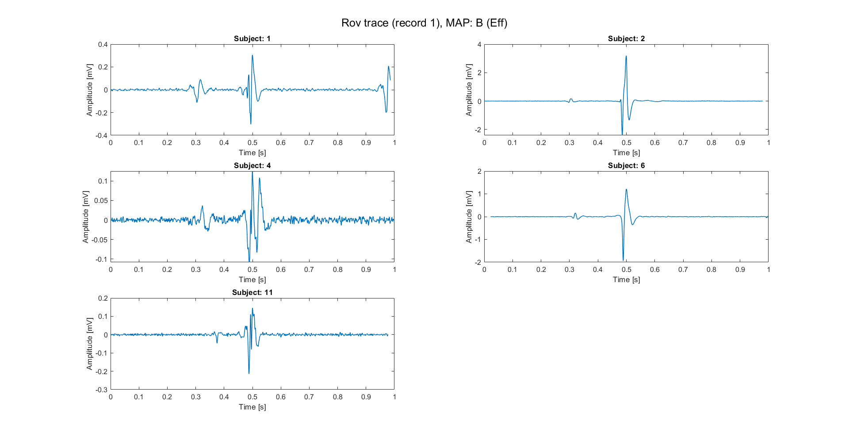
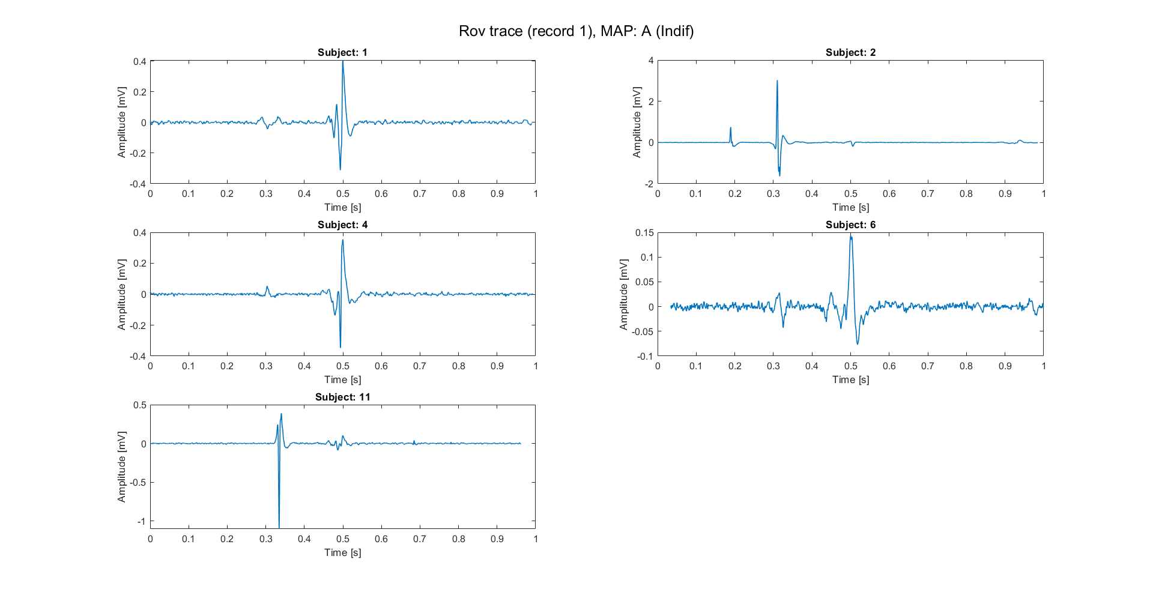
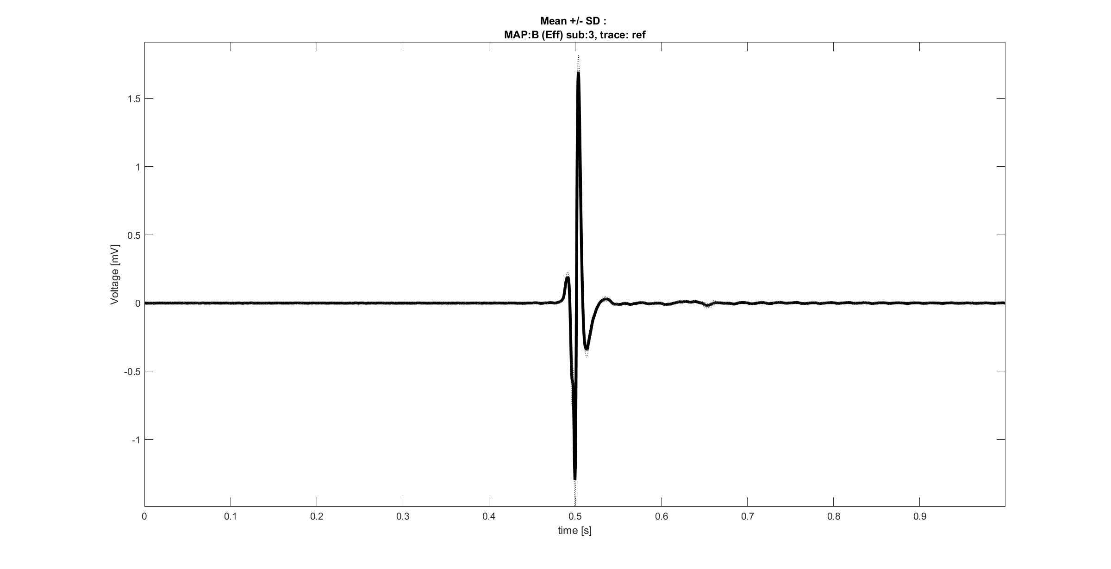
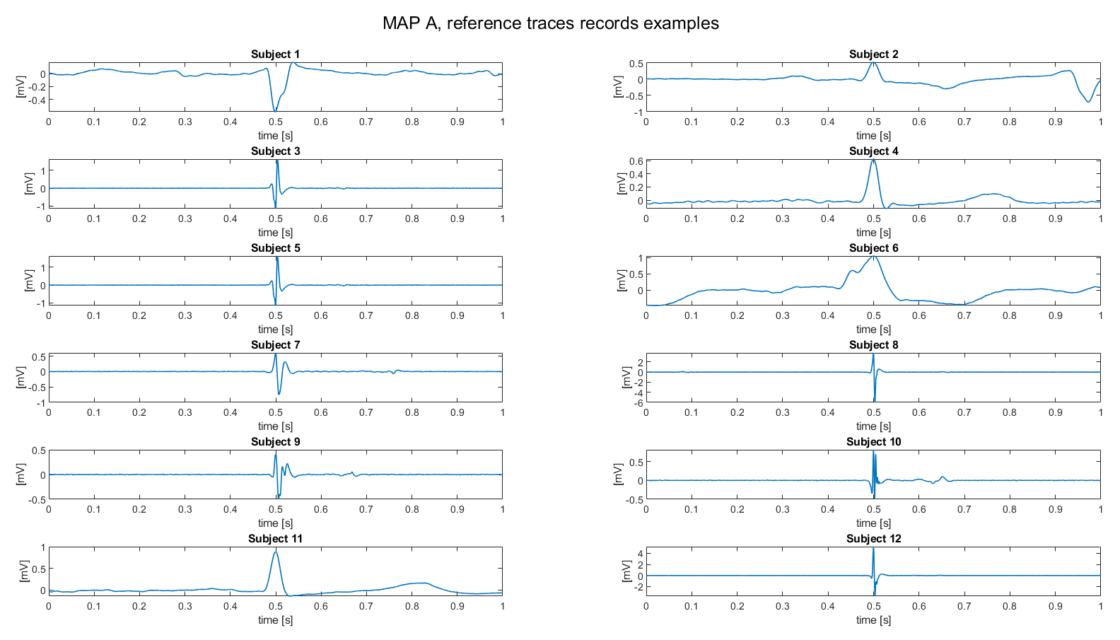
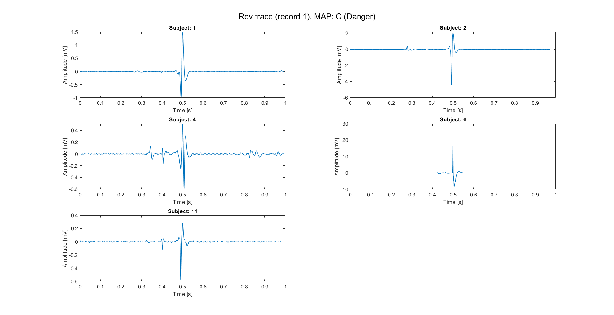
Alignment: open questions
It’s now necessary answer to some crucial questions:
Is it possible that reference traces are traces without the QRS?
Are the reference traces preprocessed by align them respect to 0.5 seconds?
Which is the nature of Spare traces?
Once answered to these questions, it could be possible building a population dataset, where all traces have a certain component (e.g., the ventricular conduction) aligned respect to a common point (e.g., 0.5 seconds).
Here, examples of aligned traces are reported. These traces are related to subjects in whom the ref trace presented a clear QRS (sub: 1,2,4,6,11).

Slide 26
Outline
Recap of objectives so far
Signal preprocessing
Spectrum estimation
Signals alignment
Possible features of Rov Signals
Conclusions

Slide 27
Next step: feature extraction
Rov signals
Morphological features (time domain)
Points of the signal, even sub-sampled [9]
Fragmentation (number of peaks of the signal) [10]
PCA/ICA representations of the signal [9]
Filter and normalize
Alignment respect to a common point
Morphological features (Frequency domain)
Mean, variance, energy of DWT coefficients on different levels of decomposition [9]
Relative power of PSD on fixed sub-bands [10]
PCA/ICA representations of frequency domain features [9]
Feature extraction on Rov records
Label
Map A, Map B, Map C
9. E. J. D. S. Luz, W. R. Schwartz, G. Cámara-Chávez, e D. Menotti, «ECG-based heartbeat classification for arrhythmia detection: A survey», Computer Methods and Programs in Biomedicine, vol. 127, pp. 144–164, apr. 2016.
10. G. Baldazzi, M. Orrù, G. Viola, e D. Pani, «Computer-aided detection of arrhythmogenic sites in post-ischemic ventricular tachycardia», Sci Rep, vol. 13, fasc. 1, p. 6906, apr. 2023

Slide 28
Outline
Recap of objectives so far
Signal preprocessing
Spectrum estimation
Signals alignment
Possible features of Rov Signals
Conclusions

Slide 29
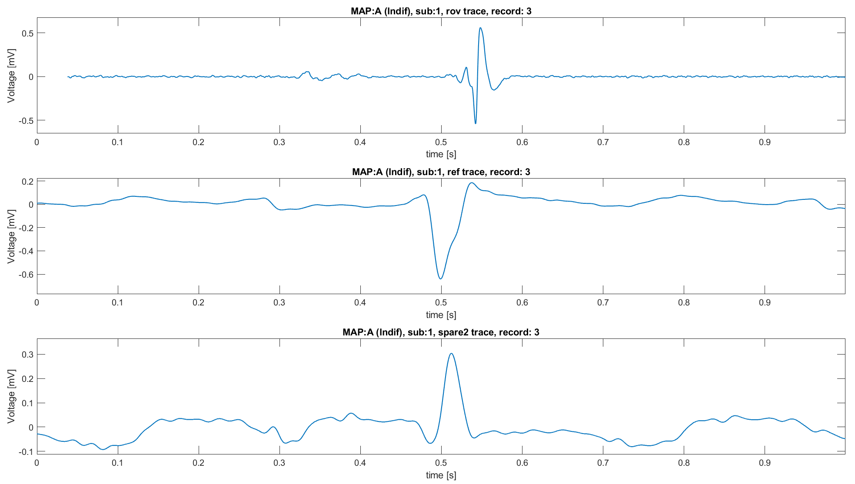
Conclusions
So far, some progress has been made on understanding the signals :
A reliable preprocessing pipeline it has been build and it’s ready in case of future necessity.
Spectrum evaluation criticalities have been studied and alternatives were proposed.
A strong and adaptable alignment strategy it has been proposed and can be used to build a population dataset
Once concluded with these aspects, there’s another open question:
Why are there signals afferent to MAP A with clearly characteristics of MAP B?
Noise and bad positioning of the electrode
Necessity of positional information to completely characterize the signal (i.e., the heart surgeon knows where he’s located with the electrode and uses this information to “classify” the signal)
Since the classification is done a posteriori (knowing the ablation result), it is possible that the signal may be afferent to a certain MAP even though its characteristics do not suggest the classification assigned to it
Why?

